Slide 1



RECIPE GENERATOR
Recipe
PRESENTED BY-
YASH SARIN

Slide 2

Table of contents
01
02
03
04
Introduction
Libraries
Results & Algorithm
Exploring & Loading Datasets

Slide 3


01
Introduction

Slide 4
In this experiment we will use character-based RNN to generate cooking recipes. We will try to teach our RNN to generate recipe name, ingredients and cooking instructions for us. I don't expect the RNN to do a strong connection between list of ingredients and cooking instructions but I do expect RNN to learn English grammar and punctuation in couple of hours and to generate some meaningful recipe names along with real food ingredients and cooking instructions. For this experiment we will use Tensorflow v2 with its Keras API.

Slide 5
02
LIBRARIES

Slide 6
TENSORFLOW
MATPLOTLIB
NUMPY
PLATFORM
TIME
PATHLIB
OS
JSON

Slide 7
03
Exploring & Loading Datasets

Slide 8
EXPLORING & LOADING DATASET
Let's go through several available dataset and explore their pros and cons. One of the requirement I want the dataset to meet is that it should have not only a list of ingredients but also a cooking instructions. I also want it to have a measures and quantities of each ingredient.
🤷 Recipe Ingredients Dataset (doesn't have ingredients proportions)
🤷 Recipe1M+ (requires registration to download)
🤷 Epicurious - Recipes with Rating and Nutrition (~20k recipes only, it would be nice to find more)
👍🏻 Recipe box (~125,000 recipes with ingredients proportions, good)
Let's load the dataset using tf.keras.utils.get_file. Using get_file() utility is convenient because it handles caching for you out of the box. It means that you will download the dataset files only once and then even if you launch the same code block once again it will use cache and the download code will be executed faster.

Slide 9
04
Results & Algorithm

Slide 10
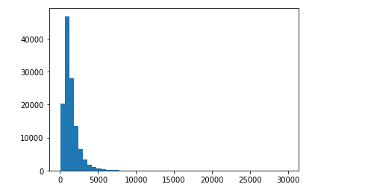
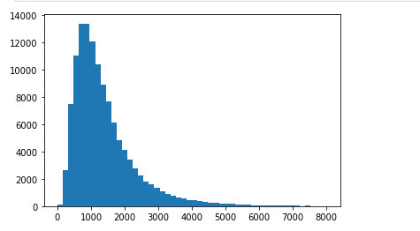
Results & Algorithm
Filtering out large receipts
Recipes have different lengths. We need to have one hard-coded sequence length limit before feeding recipes sequences to RNN. We need to find out what recipe length will cover most of recipe use-cases and at the same time we want to keep it as small as possible for training performance.

Slide 11
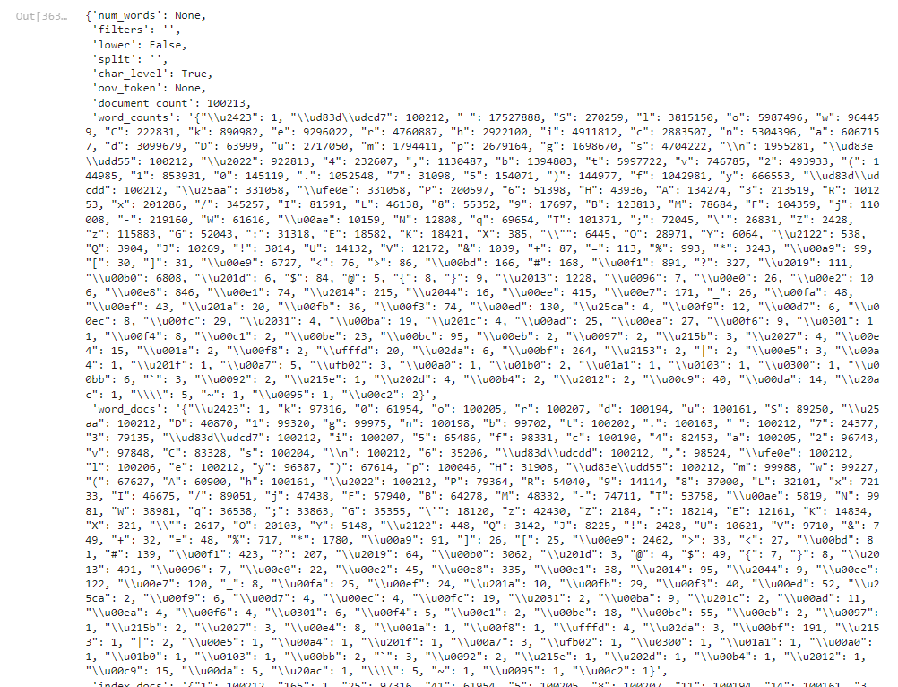
Results & Algorithm CONT…
Creating vocabulary
To create a vocabulary out of recipes texts we will use tf.keras.preprocessing.text.Tokenizer

Slide 12
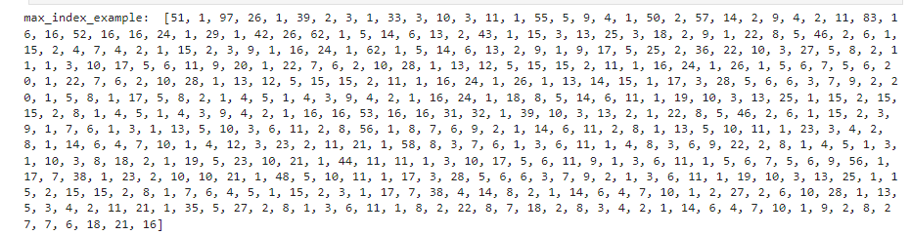
Results & Algorithm CONT…
Vectorizing the dataset
Now, once we have a vocabulary (character --> code and code --> character relations) we may convert the set of recipes from text to numbers (RNN works with numbers as an input and not with the texts).

Slide 13
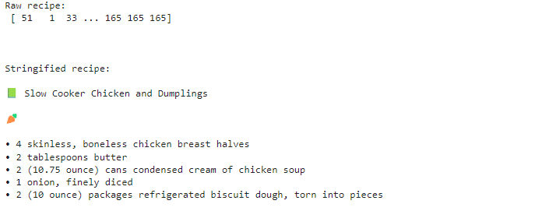
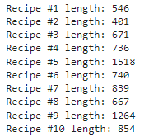
Results & Algorithm CONT…
Add padding to sequences
We need all recipes to have the same length for training. To do that we'll use tf.keras.preprocessing.sequence.pad_sequences utility to add a stop word to the end of each recipe and to make them have the same length.
Tensorflow Dataset

Slide 14
Results & Algorithm CONT…
Add padding to sequences
We need all recipes to have the same length for training. To do that we'll use tf.keras.preprocessing.sequence.pad_sequences utility to add a stop word to the end of each recipe and to make them have the same length.
Tensorflow Dataset

Slide 15
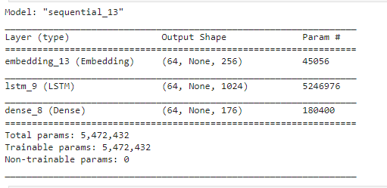
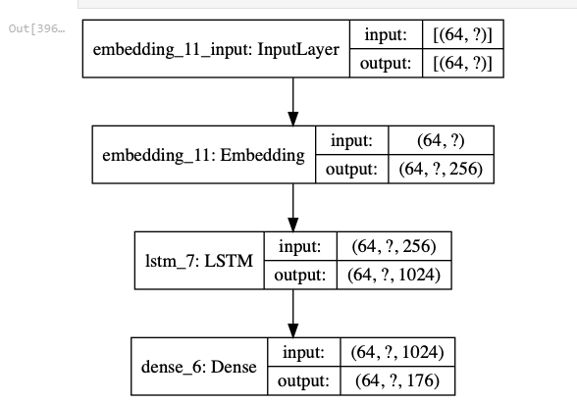
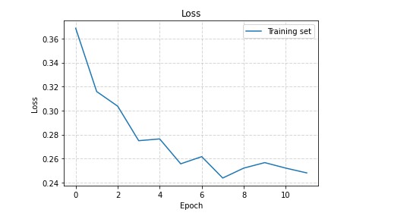
Results & Algorithm CONT…
Build the model
Use tf.keras.Sequential to define the model. For this experiment we will use the following layer types:
tf.keras.layers.Embedding: The input layer. A trainable lookup table that will map the numbers of each character to a vector with embedding_dim dimensions;
tf.keras.layers.LSTM: A type of RNN with size units=rnn_units (You can also use a GRU layer here.)
tf.keras.layers.Dense: The output layer, with vocab_size outputs.

Slide 16
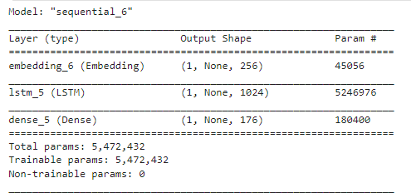
Results & Algorithm CONT…
Generating text
Restore the latest checkpoint
To keep this prediction step simple, use a batch size of 1.
Because of the way the RNN state is passed from timestep to timestep, the model only accepts a fixed batch size once built.
To run the model with a different batch_size, we need to rebuild the model and restore the weights from the checkpoint.

Slide 17
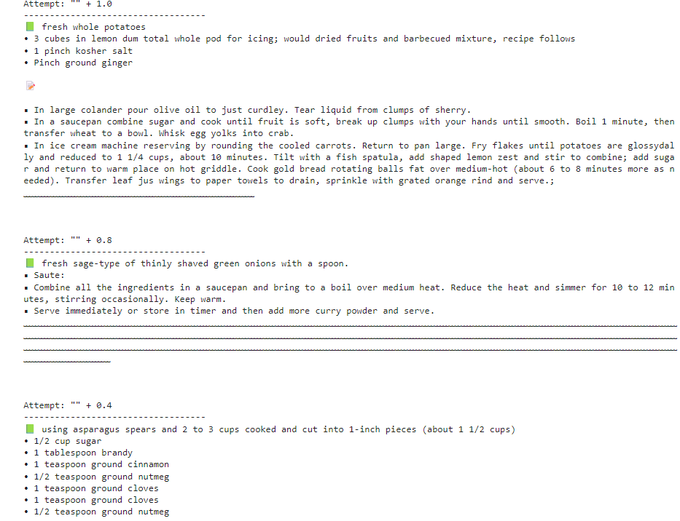
Results & Algorithm CONT…
The prediction loop
The following code block generates the text:
It Starts by choosing a start string, initializing the RNN state and setting the number of characters to generate.
Get the prediction distribution of the next character using the start string and the RNN state.
Then, use a categorical distribution to calculate the index of the predicted character. Use this predicted character as our next input to the model.
The RNN state returned by the model is fed back into the model so that it now has more context, instead than only one character. After predicting the next character, the modified RNN states are again fed back into the model, which is how it learns as it gets more context from the previously predicted characters.

Slide 18
THANK YOU

